Slide 1
CHBE 470: Process Dynamics and Control
Prof. Rafael Verduzco, rafaelv@rice.edu
Fall Semester 2022

Slide 2
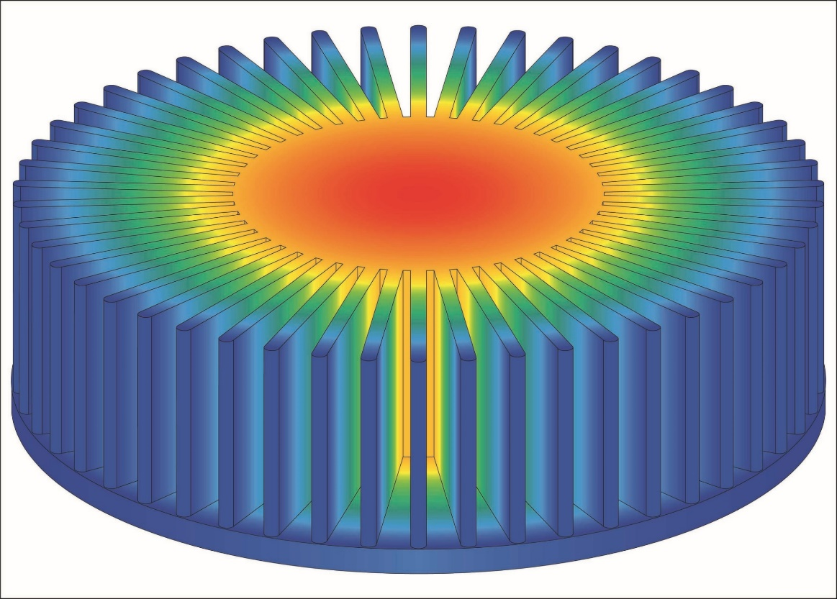
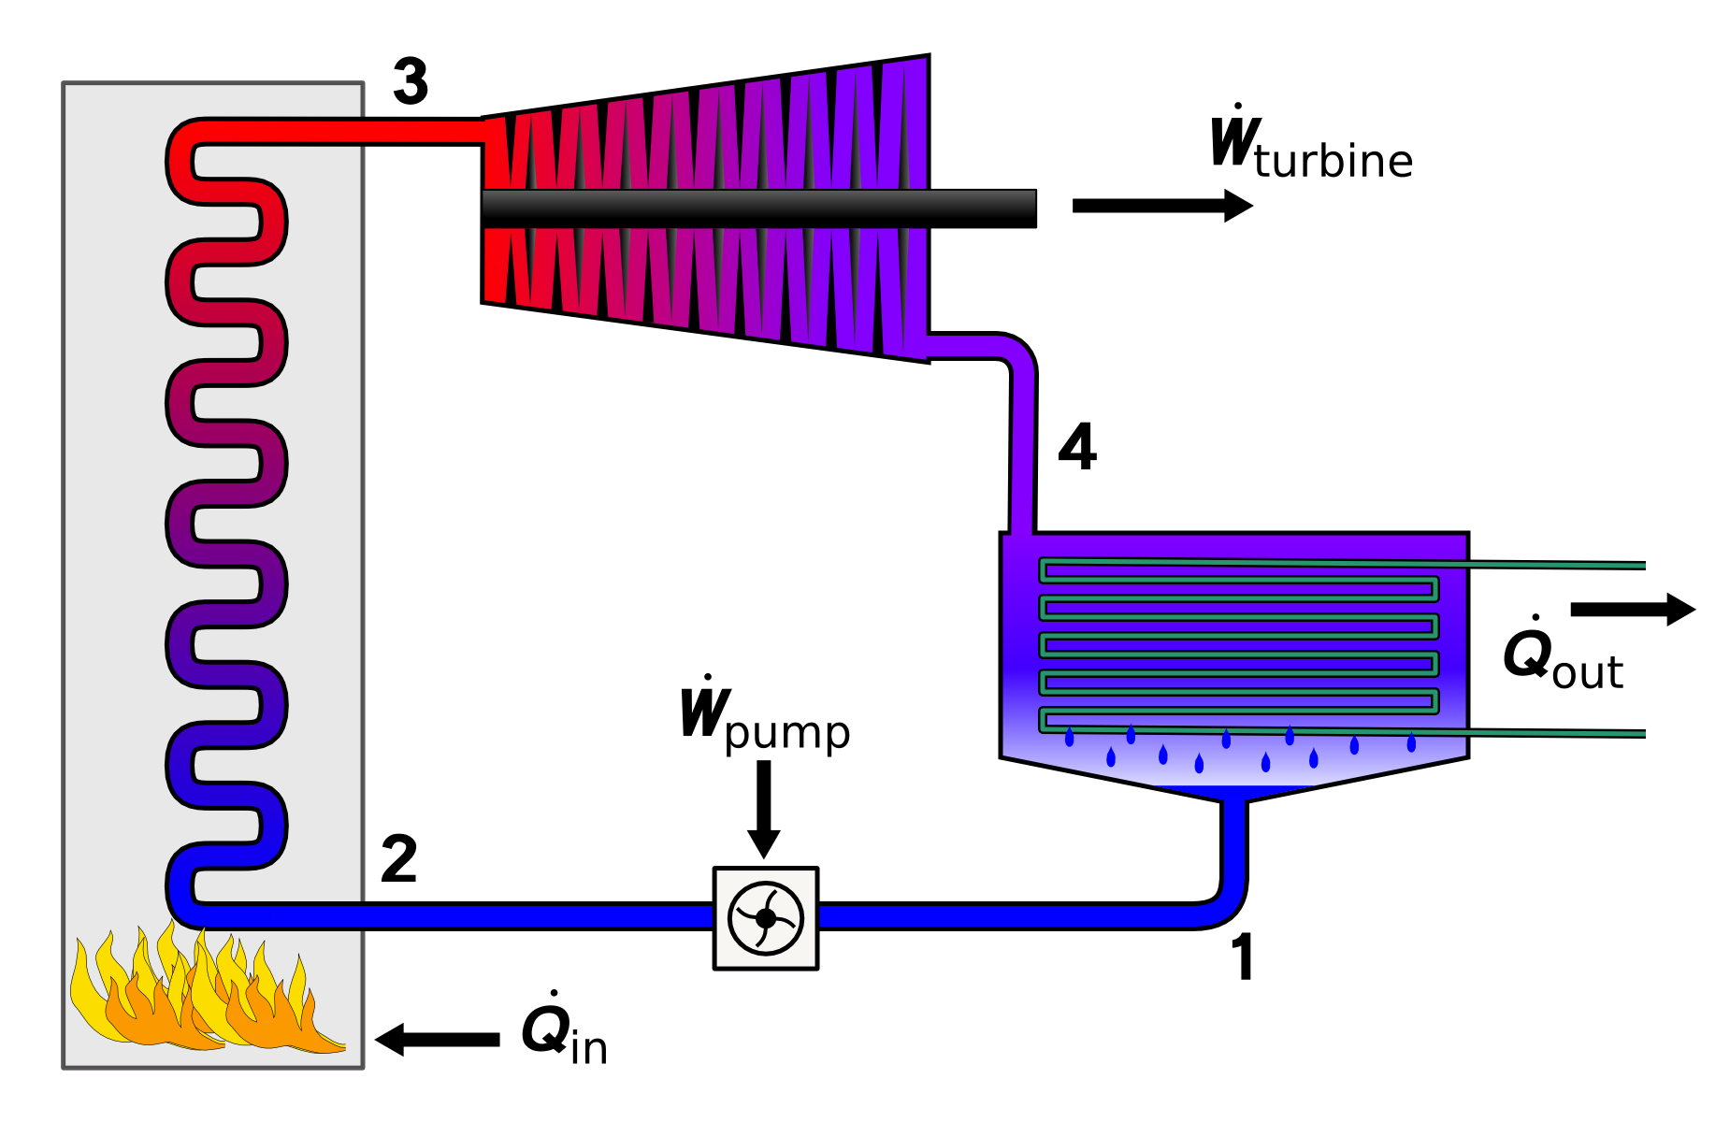
Prior courses focused on steady-state processes
Heat Transfer
Thermodynamics
Notes:
Heat Transfer

Slide 3
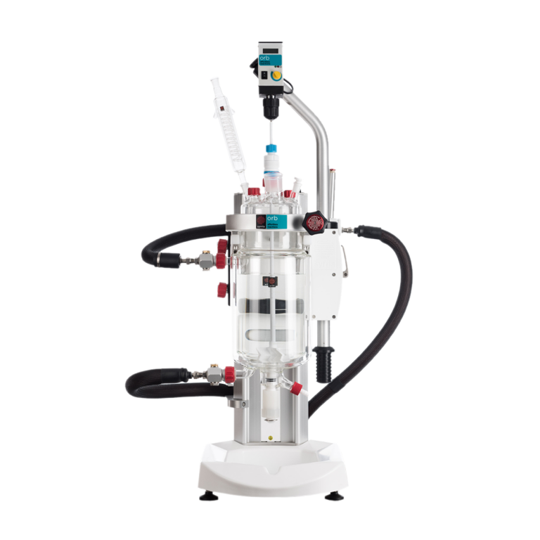
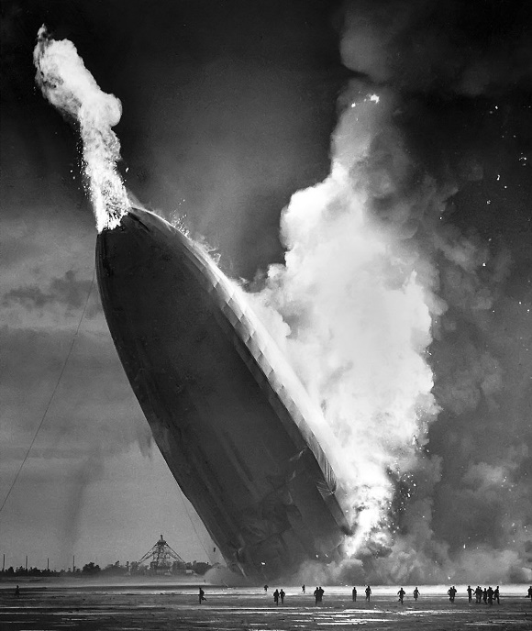
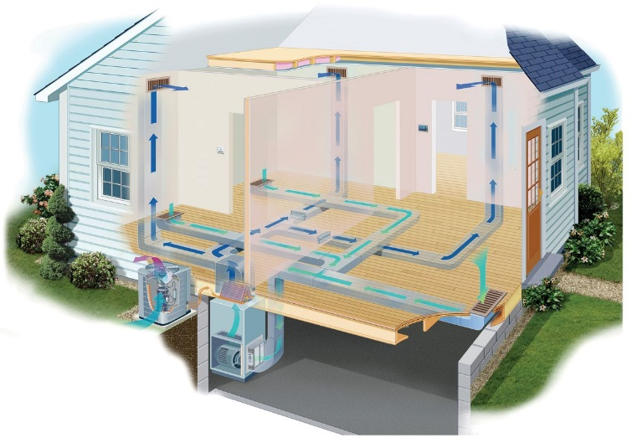
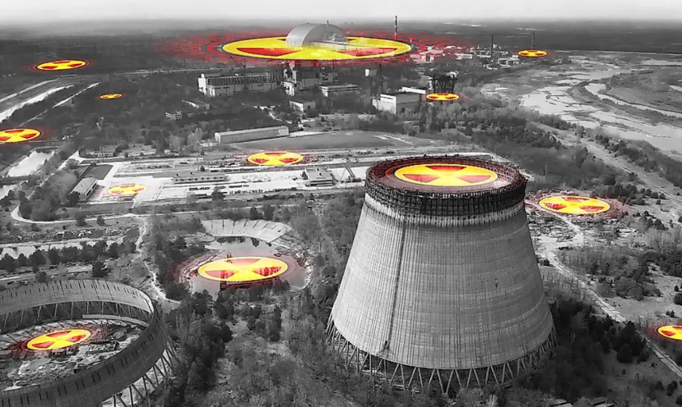
Most real-world processes are not at steady-state, and adjustments are required to maintain a target

Slide 4
Process Dynamics and Control
Process Dynamics: What happens when processes are not at steady state?
Process Control: How can we ensure that processes stay at steady state at desired conditions?

Slide 5

https://www.thisoldhouse.com/heating-cooling/21018992/read-this-before-you-install-central-air-conditioning

Slide 6


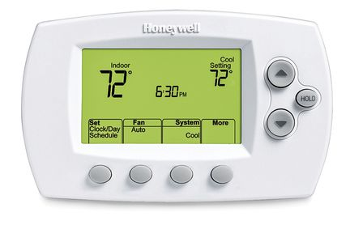
Feedback Control
https://www.thisoldhouse.com/heating-cooling/21018992/read-this-before-you-install-central-air-conditioning

Slide 7
Set point
Notes:
Set point

Slide 8
Feedback Dynamics and Control
Dynamics: How does the process respond to a change in the inputs?
Control: How do we achieve a desired operating state?

Slide 9
What is the best control strategy?
Deviation of the temperature from a setpoint (Proportional Control)
Integral of the temperature offset (Integral Control)
Derivative of the temperature (Derivative Control)
Set point
Notes:
Deviation of the temperature from a setpoint (Proportional Control)
Integral of the temperature offset (Integral Control)
Derivative of the temperature (Derivative Control)

Slide 10
CSTR Reactor– what happens when the feed temperature changes?

Slide 11
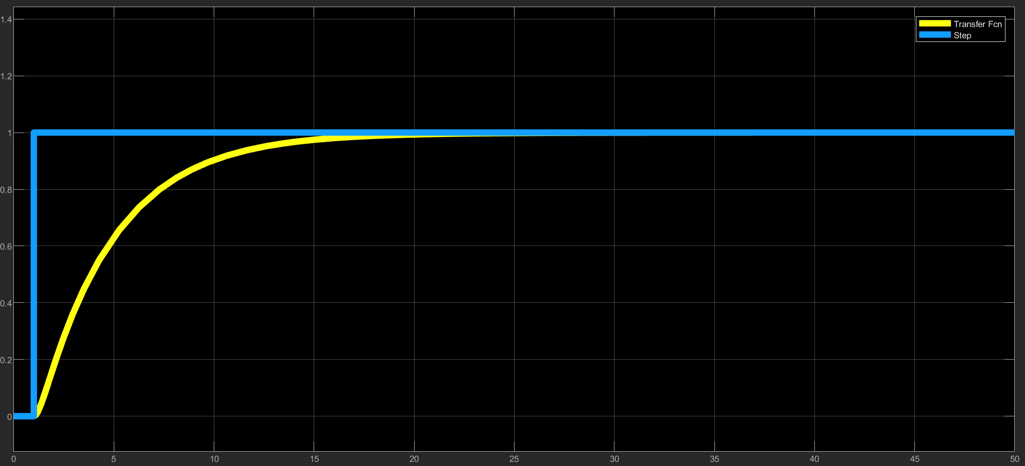
Process Dynamics – Response to Disturbance
Feed Temperature (Step Change)
Product Concentration
Notes:
Feed Temperature (Step Change)

Slide 12
Process Dynamics – Response to Disturbance
Feed Temperature (Step Change)
How quickly and by how much does the product temperature and composition change?
Does the reactor reach a stable steady-state?
How might fluctuations in feed temperature, feed composition, or heating medium temperature influence the reactor?
Product Concentration
Partial Differential Equation – temperature and concentration are changing with time
Notes:
Partial Differential Equation – temperature and concentration are changing with time

Slide 13
Process Control – how do we get the system back to the desired set point?
Example control responses:
Decrease the flow rate of the heating medium
Decrease/Increase the flowrate of the feed
Decrease/Increase the flowrate of the product

Slide 14
Process Dynamics – what happens when the feed temperature changes?
Process control is needed to deal with disturbances. These can include fluctuations in feed temperature and concentration, fluctuations in the temperature of the heating medium, and the pressure in the heating fluid upstream of the valve.
Control is required to keep the reactor operating safely and at the desired conditions.
Control also enables changing the desired values

Slide 15
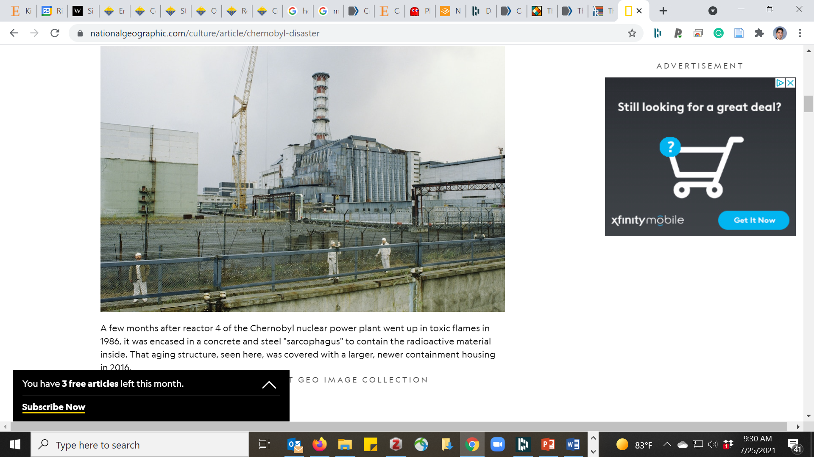
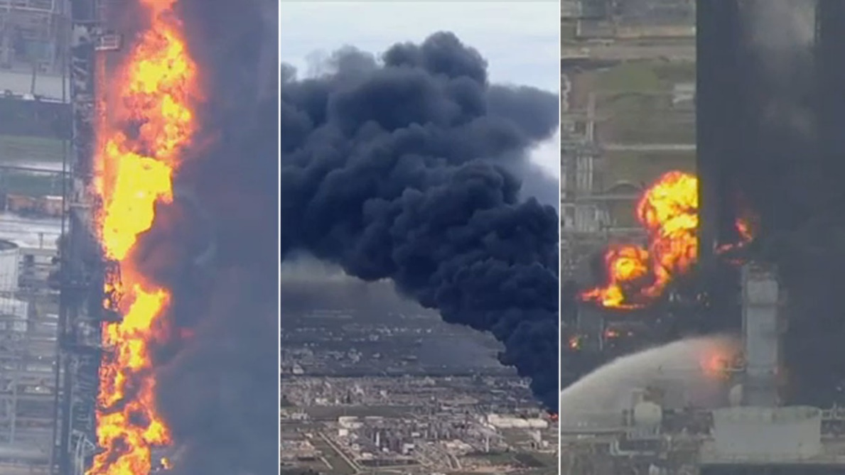
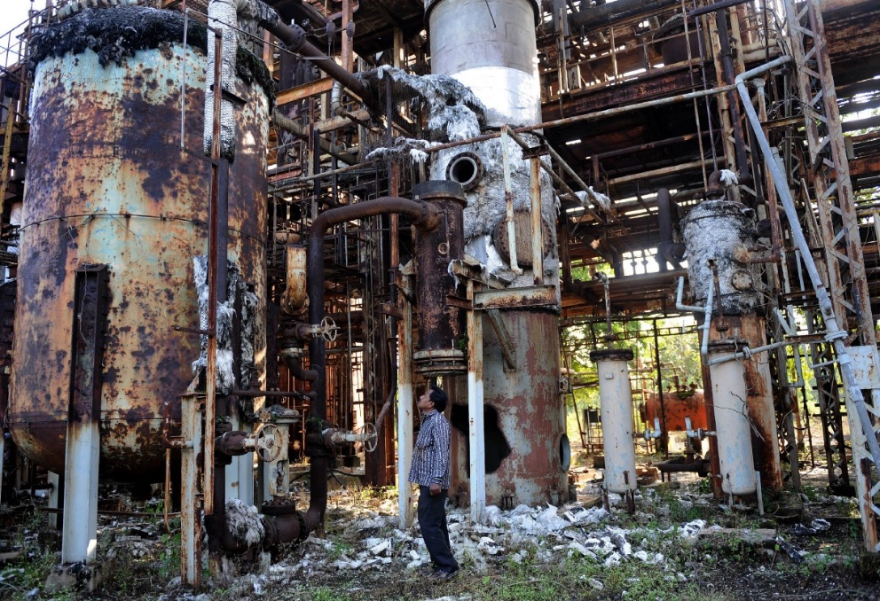
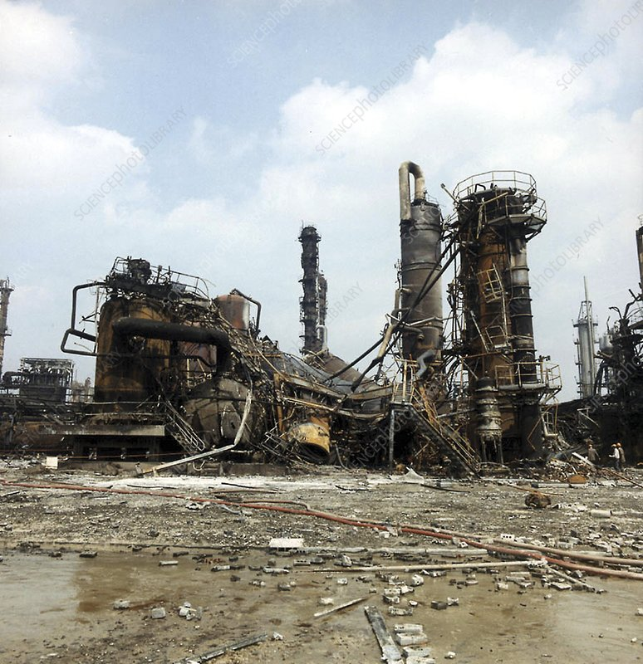
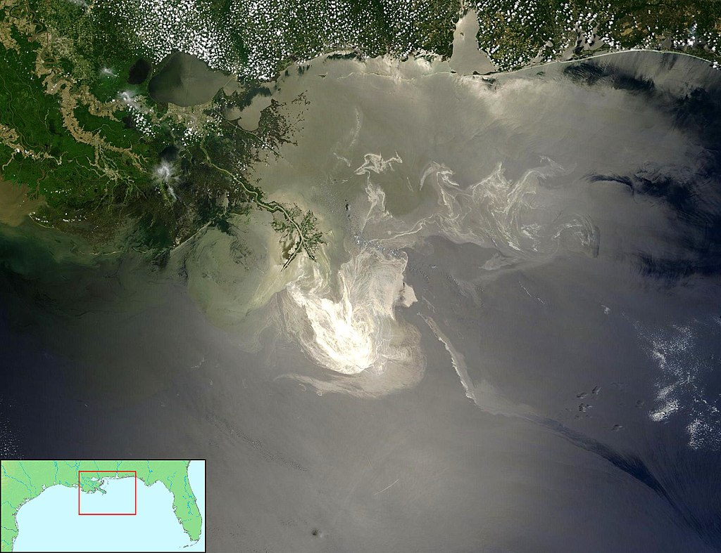
Chernobyl 1986
Philips Disaster in Pasadena, Texas 1989
Bhopal India 1984
Flixborough UK 1974
Deepwater Horizon 2010
Notes:
Philips Disaster in Pasadena, Texas 1989: During routine maintenance, isolation valves were closed and compressed air hoses that actuated them physically disconnected as a safety measure. The air connections for opening and closing this valve were identical, and had been improperly reversed when last re-connected. As a result, the valve would have been open while the switch in the control room was in the "valve closed" position. After that, the valve was opened when it was expected to stay closed, and finally passed the reactor content into air
Bhopal India: Estimates of the death toll vary from as few as 3,800 to as many as 16,000, but government figures now refer to an estimate of 15,000 killed over the years. nion Carbide India's Bhopal facility housed three 68,000-litre liquid MIC storage tanks: E610, E611, and E619. Months before the tragedy, MIC production was in progress and was being filled in the tanks. No tank was allowed to be filled more than 50% of its capacity and the tank was pressurized with inert nitrogen gas. The pressurization allowed liquid MIC to be pumped out of each tank. However, one of the tanks (E610) lost the ability to contain nitrogen gas pressure, hence liquid MIC could not be pumped out of it. As per the rules, each of the tanks could not be filled with more than 30 tonnes of liquid MIC. But this tank had 42 tonnes. This failure forced UCIL to halt methyl isocyanate production in Bhopal and the plant was partly shut for maintenance. An attempt was made to make the defective tank functional again on December 1, however the attempt failed. By then, most of the plant's methyl isocyanate related safety systems were malfunctioning. According to reports, by December 2 eve, water had entered the malfunctioning tank, which resulted in runaway chemical reaction. The pressure in the tank increased five times by night. By midnight, the workers in the MIC area started feeling the effects of MIC gas. The decision to address the leak was to be made a couple of minutes later. However, by then the chemical reaction in the tank had reached a critical state. About 30 tonnes of MIC escaped from the tank into the atmosphere within an hour. Most Bhopal residents were made aware of the gas leak by exposure to the gas itself.
Flixborough UK: The disaster involved (and may well have been caused by) a hasty equipment modification. Although virtually all of the plant management personnel had chemical engineering qualifications, there was no on-site senior manager with mechanical engineering expertise. Mechanical engineering issues with the modification were overlooked by the managers who approved it, and the severity of potential consequences due to its failure were not taken into account.
Deepwater Horizon 2010: Although BP attempted to activate the rig’s blowout preventer (BOP), a fail-safe mechanism designed to close the channel through which oil was drawn, the device malfunctioned. Forensic analysis of the BOP completed the following year determined that a set of massive blades known as blind shear rams—designed to slice through the pipe carrying oil—had malfunctioned because the pipe had bent under the pressure of the rising gas and oil.

Slide 16
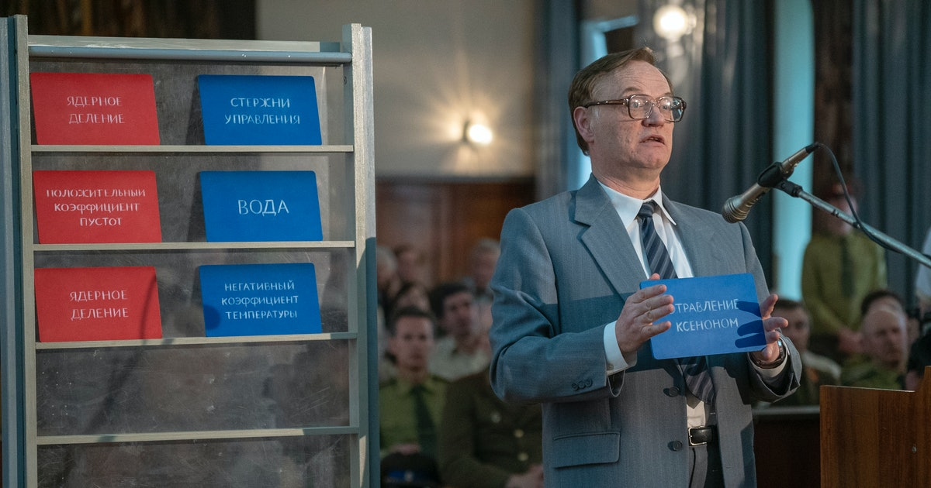
Chernobyl (HBO)
Part 1: https://www.youtube.com/watch?v=DDBkMIwb9Mk
Part 2: https://www.youtube.com/watch?v=3azNLCo0wyU
Part 3: https://www.youtube.com/watch?v=IzbOgvWQhHA

Slide 17
Understanding the fundamental principles of process control is absolutely essential to ALL chemical processes.

Slide 19
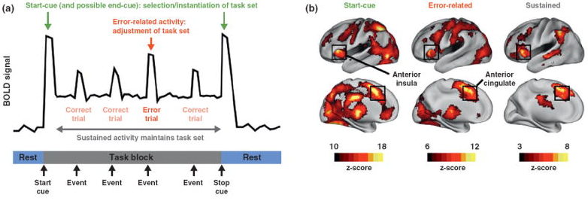
Curr Opin Neurobiol. 2013 Apr; 23(2): 223–228.
DOI: 10.1016/j.conb.2012.12.009

Slide 20

Never Enough: The Neuroscience and Experience of Addiction
A response: The effect the drug has on the brain
B response: The response of the brain to the drug. The brain adjusts the set point, and responds with an exactly opposite response.
This gives rise to withdrawal symptoms and dependency

Slide 21
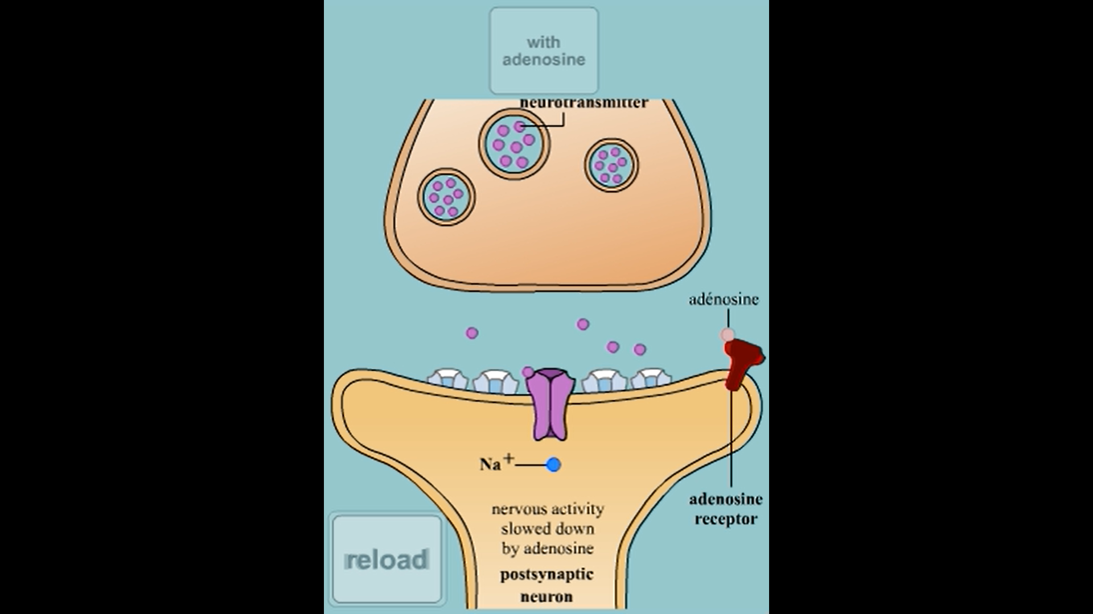
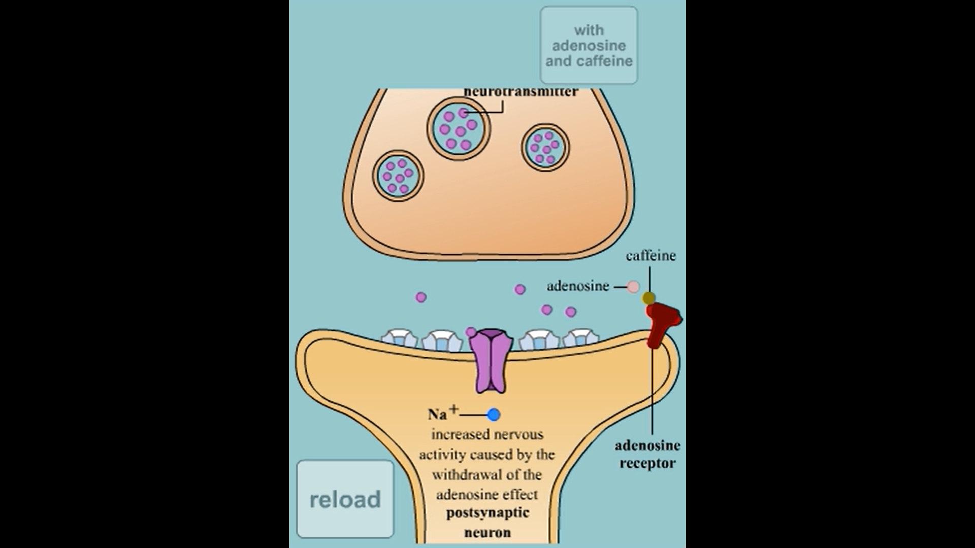
https://thebrain.mcgill.ca/flash/i/i_03/i_03_m/i_03_m_par/i_03_m_par_cafeine.html
Notes:
Talk about the A and B response in the brain; increasing the drug temporarily increases wakefulness, but your brain adjusts, produces more adenosine. You might eventually hi a “wall”. It also means that in the future, you might need caffeine just to fell normal.

Slide 22
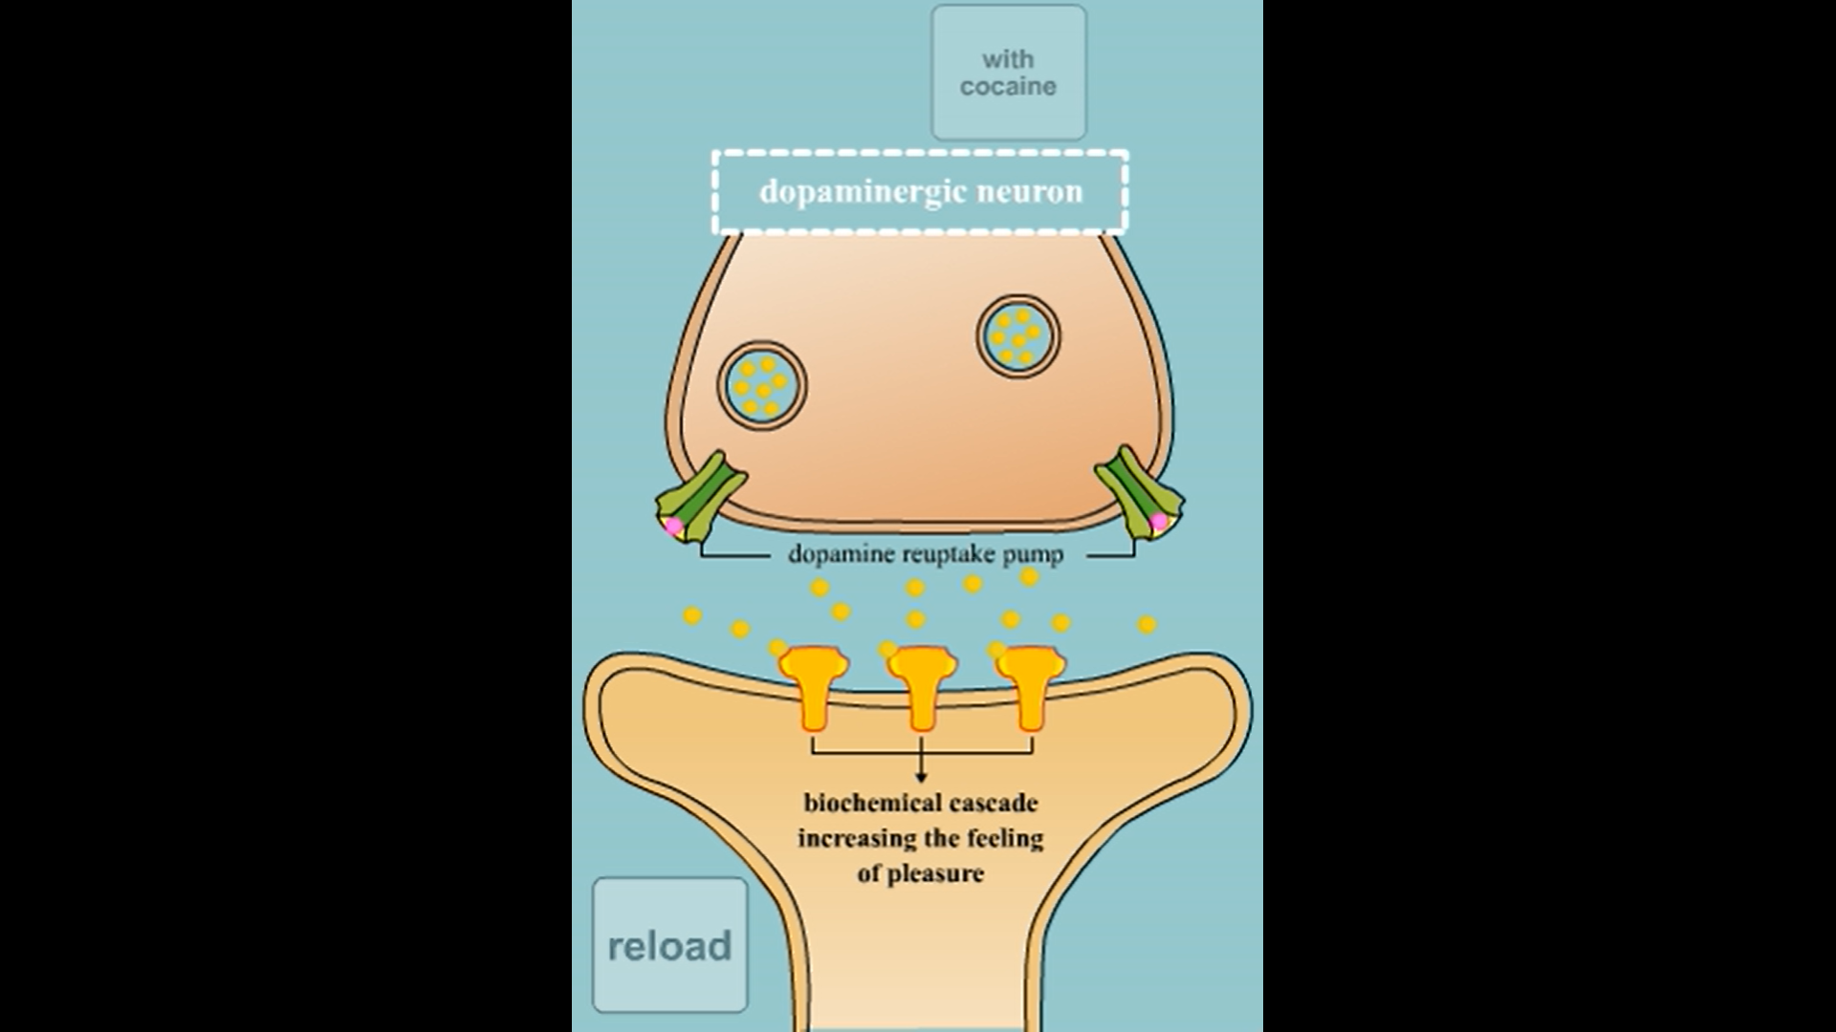
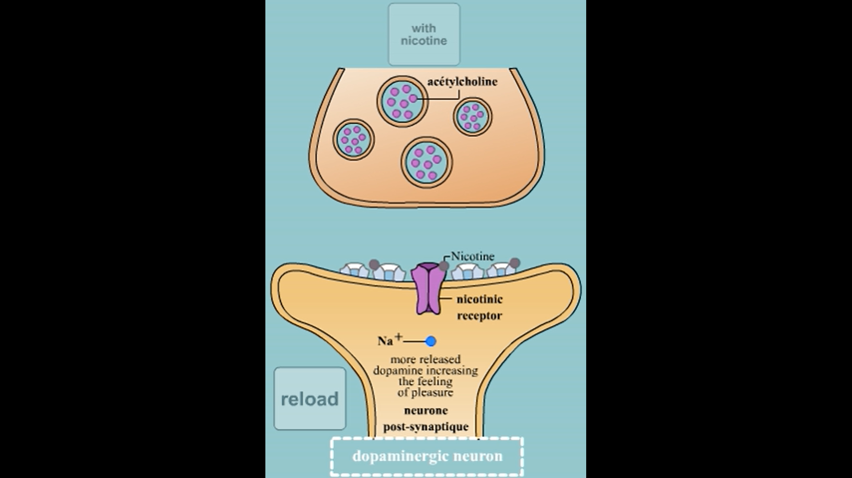
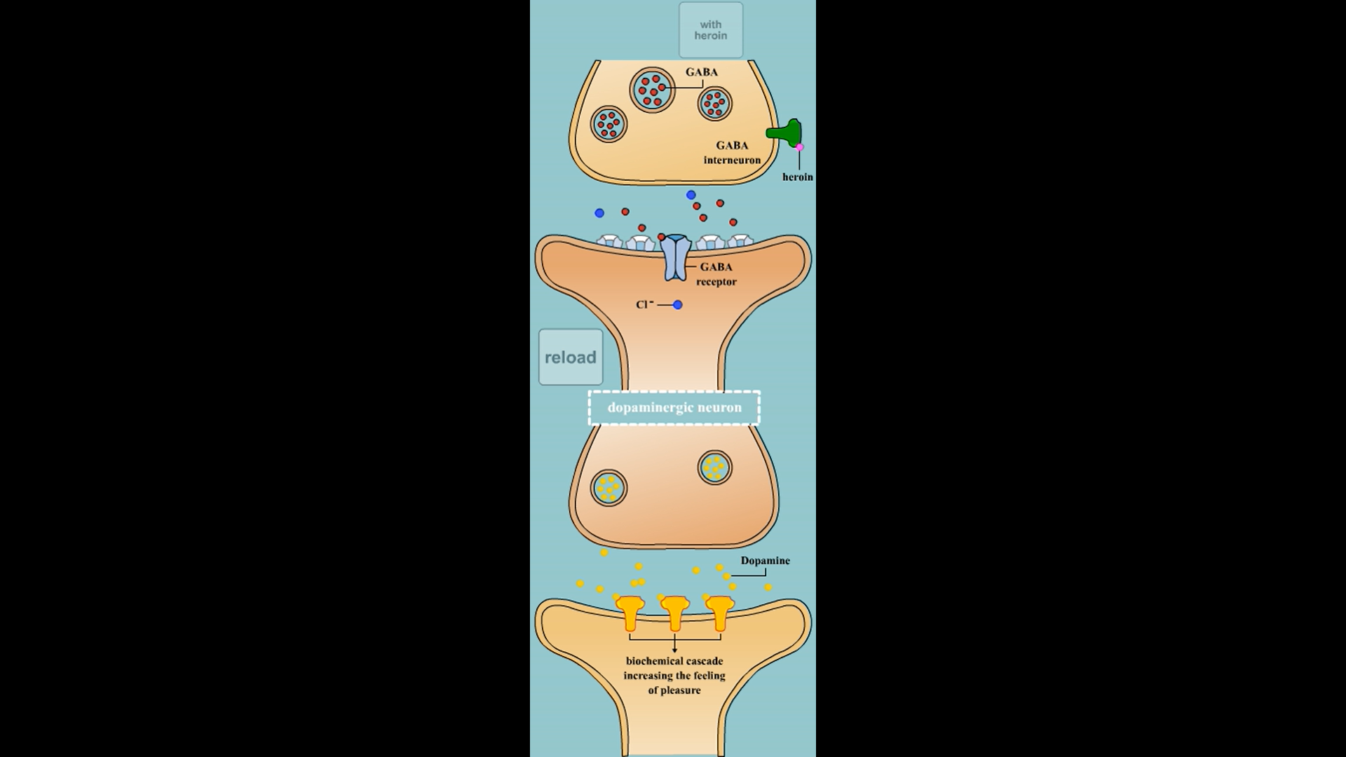
Cocaine
Nicotine
Opiates
Notes:
Cocaine

Slide 23

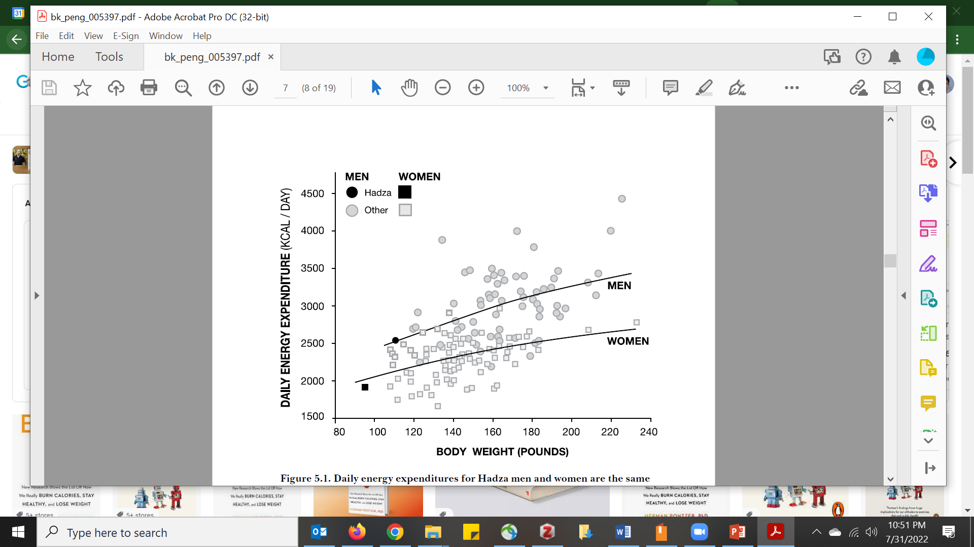
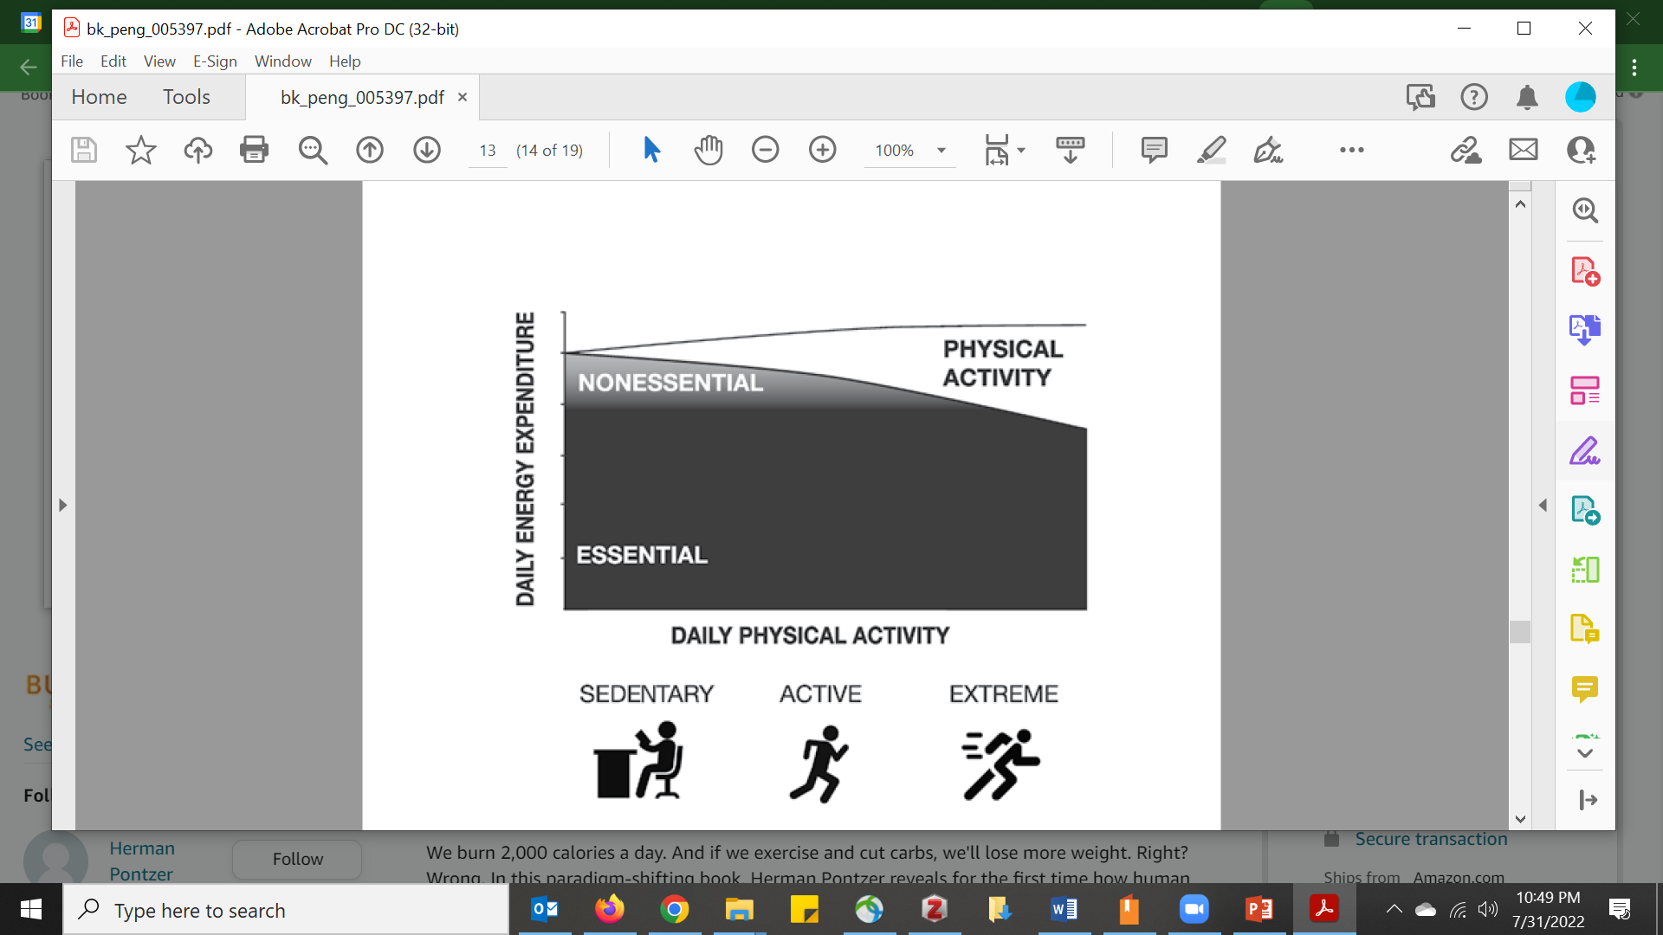
Human metabolism is a tightly regulated process

Slide 24
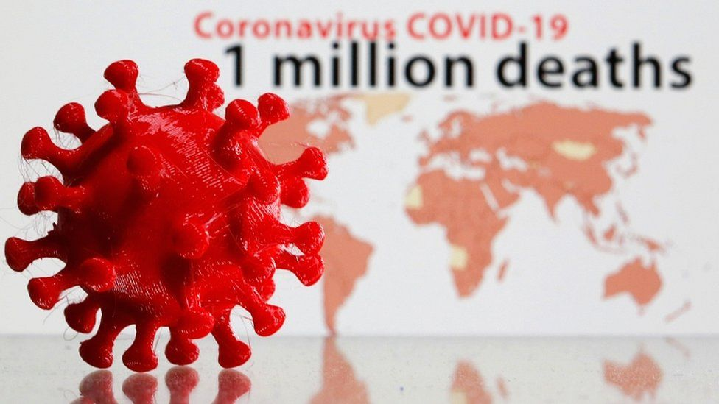
https://www.bbc.com/news/world-54337098
Notes:
Global pandemic

Slide 25
Other examples of process dynamics/control?
Conservation efforts – animal and plant species
Climate change
Economic activity
Teaching/Learning
Parenting
Sports/games
Stuff we do without thinking (open a door, walk. Etc.)
Eating/weight control

Slide 26
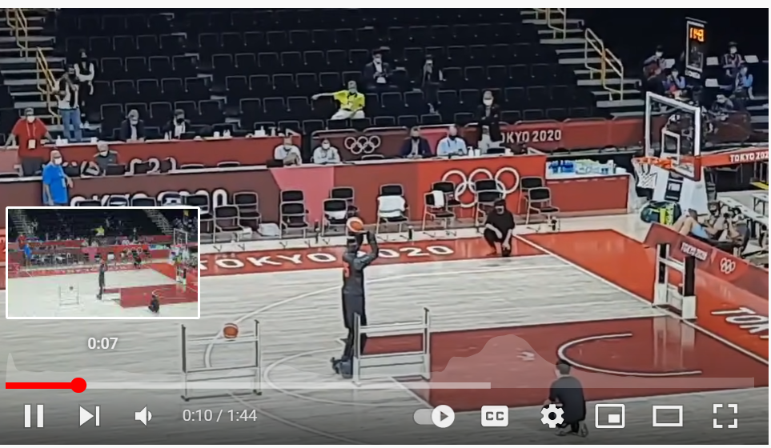
https://www.youtube.com/watch?v=4mnK-1Und_0

Slide 27
Feedback Dynamics and Control
Dynamics: How does the process respond to a change in the inputs?
Control: How do we achieve a desired operating state?

Slide 28
What you will learn in this course
How to identify feedback control processes
How to model dynamic processes (non steady-state)
How to simulate dynamic processes and predict the response
How to develop process control strategies
How to tune, optimize, and analyze control strategies
How to determine the stability of a control strategy

Slide 29
About Prof Verduzco
Rice Undergrad (class of 2001), Chemical Engineering
Has taught at Rice for 12 years: Thermodynamics (8 years), Heat/Mass transfer (2 years), Graduate courses on polymers and surface analysis; undergraduate course on preparing a thesis and applying to graduate school.
Second time teaching process control
Teaching style – active/engaging. Lecture on a topic + examples + in class problems
Please interrupt with questions or email me with questions, especially if you see an error
Random Facts: two kids, just got a dog, like video games (Switch) will challenge you to Mario Kart; enjoys sports (running, biking, basketball), watching NBA
Current research topics of interest: polymeric membranes for water treatment, bioelectronics, porous materials and flow chemistry

